Slide 1

Energy Harvesting Embedded Systems
Lightning Presentation
Mikail Gordon, Nick Iverson, Kit Moore

Slide 2
Problem Statement
Develop a microcontroller-based sensor prototype.
log temperature data without a power supply or battery for at least 30 days.
Power using different types of transducers:
Solar
RF
Heat
Vibration

Slide 3
Progress – Multi Year Project
Milestone #1
Connecting to a temperature sensor.
Milestone #2
Milestone #3
Microcontroller comparison and prototype software.
Power consumption metrics across various states.
Analysis of energy harvesting techniques.
Energy harvesting transducer prototype.
Milestone #4
Completed research on energy harvesting power manager ICs.

Slide 4
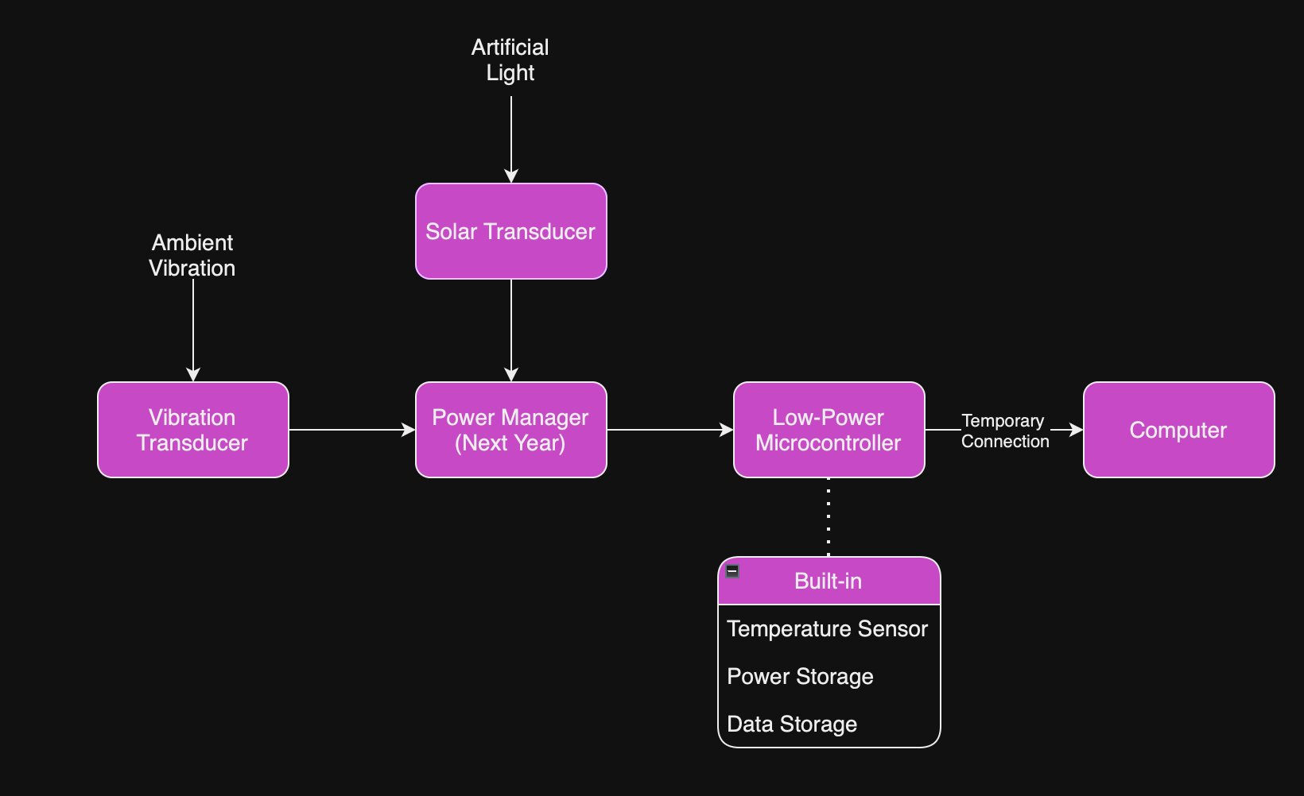
Logical Design

Slide 5
Physical Design

Slide 6
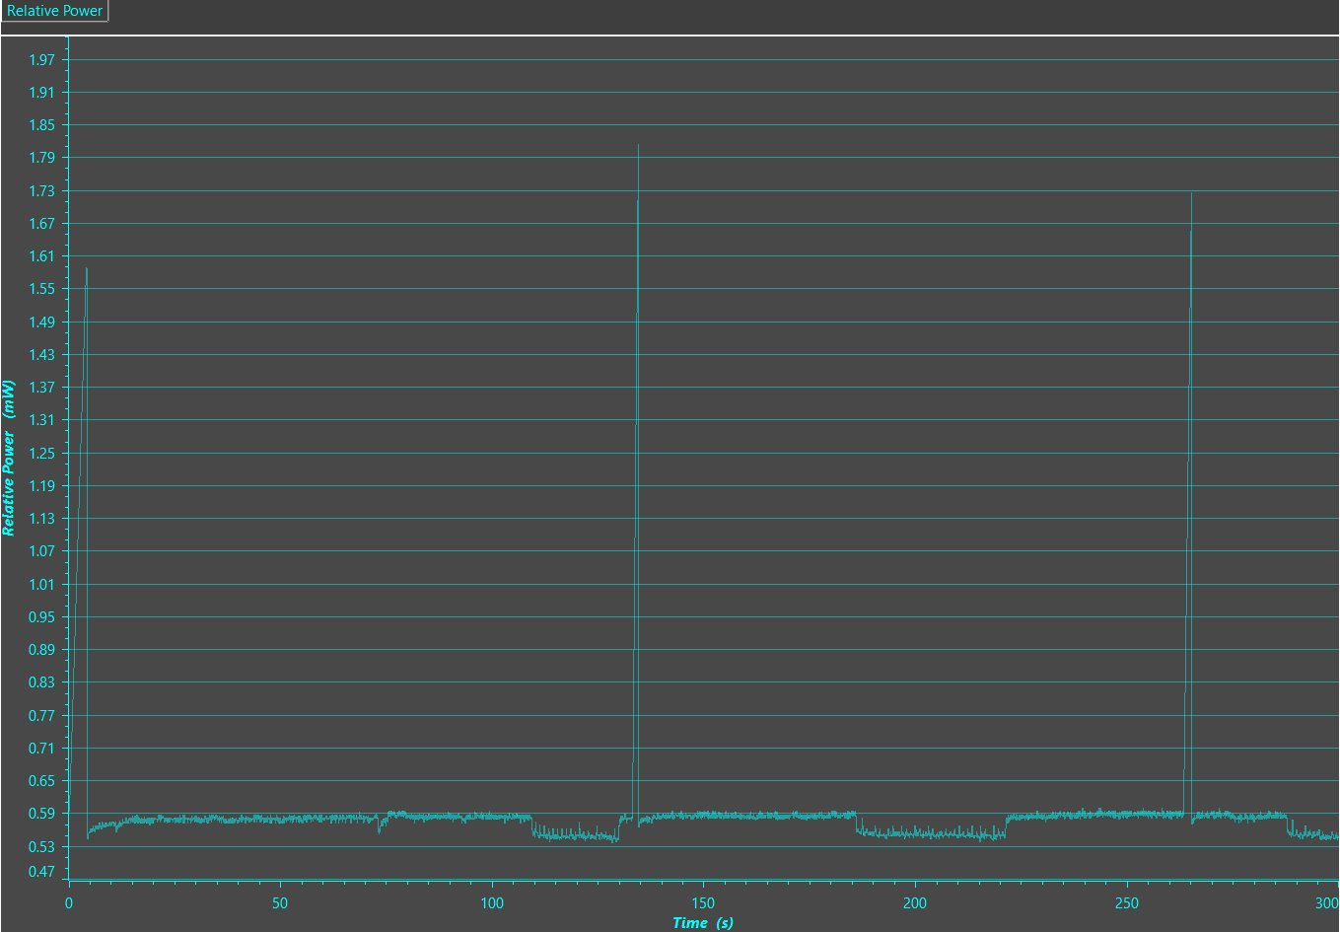
Microcontroller
Testing with Low Power Modes (LPM) have gotten ambient power draws down to 3µW
Average running power draw appears to be ~5µW
Modern mechanical watches require of the order of 1 µW of power on average

Slide 7

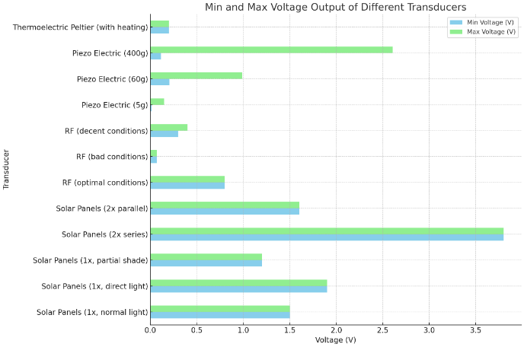
Data & Results Transducers
The voltage output of each transducer.
How each transducer operates under different conditions.

Slide 8

Theoretical Microcontroller Life
The system currently uses ~5µW
We expect the power manager to take ~40µW
Transducers produce ~90µW
Microcontroller last for 3 hours and 30 minutes without transducers.
Theoretically the microcontroller can last indefinitely

Slide 9
Next Steps
Milestone 3
Milestone 4
Milestone 5
Full project integration onto a PCB, system testing, and enclosure design.
Acquire power manager, integrate with Milestone 2's output, and test with the low-power microcontroller prototype.
Development of a PC transfer system.

Slide 10

Thank you
Special thanks to our valued stakeholder for their invaluable support and contribution.

